Slide 1
Creating Graphics in Java
with Standard Draw

Slide 2
What is Standard Draw?
Java graphics can be VERY complicated. Luckily, there’s a class called StdDraw (Standard Draw) that can simplify it a little for us.
StdDraw is not a part of the Java that is already installed on your computer. It’s a class coded by Robert Sedgewick and Kevin Wayne of Princeton University.
You need to add the StdDraw class to your project to use it.

Slide 3
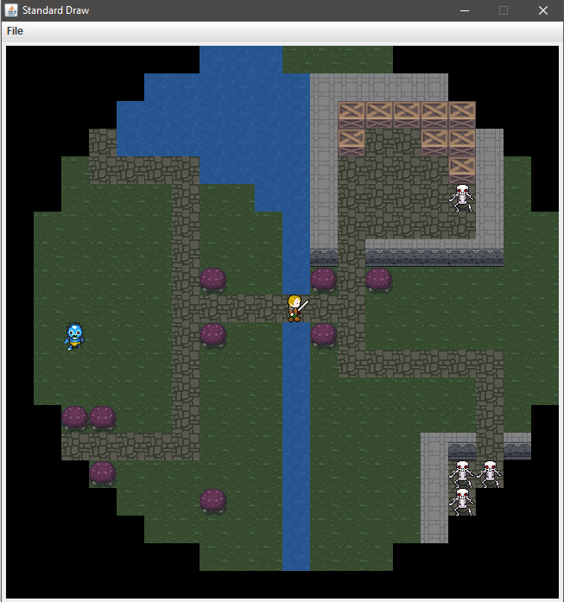
What can I do with Standard Draw?
Standard draw makes it much easier to:
Create a graphics window
Draw simple shapes
Load images
Collect user input from keyboard and mouse
Here is a demo of a lab assignment
made using StdDraw for Mr. McCoy’s Advanced Computer Science class.
Watch Mr. McCoy’s Ultima Demo on YouTube

Slide 4
Getting StdDraw into your project
To use all the helpful methods inside the StdDraw class, we need to add it into our BlueJ Project. Here are a couple ways to do this:
Download this StdDraw.java file to your computer and drag it into your BlueJ project.
OR
Create a new class in your project called StdDraw. Click this link to StdDraw.java and copy/paste all the code from the link into your StdDraw class in your project.

Slide 5
Full Standard Draw API
API stands for Application Programming Interface. Think of it as the official user’s manual.
In these notes, I’ll only be showing you some of the basics. If you want to see everything that you can do with StdDraw.java, please refer to the API document.
API: javadoc for Class StdDraw

Slide 6
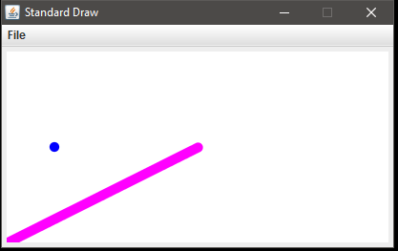
Simple Drawing Demo
Take a look at this demo program and its output.
public static void main(String[] args)
{
StdDraw.setCanvasSize(400, 200);
StdDraw.setXscale(0, 400);
StdDraw.setYscale(0, 200);
StdDraw.setPenRadius(.02);
StdDraw.setPenColor(StdDraw.BLUE);
StdDraw.point(50, 100);
StdDraw.setPenColor(StdDraw.MAGENTA);
StdDraw.line(0, 0, 200, 100);
}
These first 3 lines set the size of the graphics window and the min/max scaling. The window will be 400 wide by 200 tall. The x scale will go from 0 to 400. The y scale will go from 0 to 200.
Window has a width (and Xscale) of 400.
Point was drawn at (50, 100) using the current pen color and pen radius
height (and Yscale) of 200.
(0, 0) is located in the bottom left corner.
The line was drawn from (0, 0) to (200, 100)

Slide 7
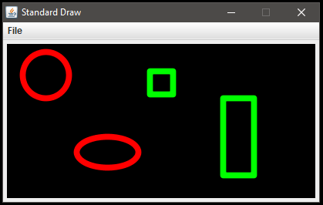
Simple Drawing Demo
Let’s add more to the demo program.
StdDraw.clear(StdDraw.BLACK);
StdDraw.setPenColor(StdDraw.RED);
StdDraw.circle(50, 160, 30);
StdDraw.ellipse(130, 60, 40, 20);
StdDraw.setPenColor(StdDraw.GREEN);
StdDraw.square(200, 150, 15);
StdDraw.rectangle(300, 80, 20, 50);
Clears the canvas and repaints it a desired color.
This square is centered at (200, 150) and has a halfLength of 15.
Rectangle centered at (300, 80) with a halfWidth 20 and halfHeight 50.
This circle is centered at (50, 160) and has a radius of 30.
Note: halfWidth, halfHeight, and halfLength are similar to a radius in that they are measured from the center.
A square with a halfLength of 15 would actually be 30 pixels long, just like a circle with radius 15 would have a diameter of 30.
This ellipse is centered at (130, 60) and has a halfWidth of 40 and a halfHeight 20.

Slide 8
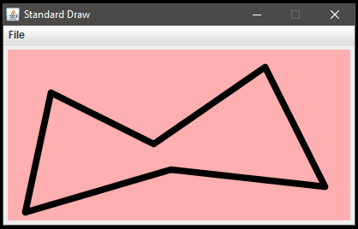
Simple Drawing Demo
Let’s add a more complex user-defined polygon.
StdDraw.clear(StdDraw.PINK);
StdDraw.setPenColor(StdDraw.BLACK);
double[] xValues = { 50, 170, 300, 370, 190, 20};
double[] yValues = {150, 90, 180, 40, 60, 10};
StdDraw.polygon(xValues, yValues);
The xValues and yValues arrays define the (x, y) pairings for the points of our shape. You can have as many points as you’d like by simply putting more data in the arrays.
(50, 150)
(170, 90)
(300, 180)
(370, 40)
(190, 60)
(20, 10)

Slide 9
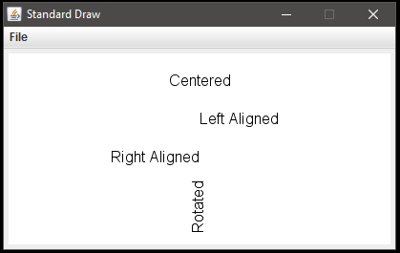
Adding Text
StdDraw.clear(StdDraw.WHITE);
StdDraw.setPenColor(StdDraw.BLACK);
StdDraw.text (200, 170, "Centered");
StdDraw.textLeft (200, 130, "Left Aligned");
StdDraw.textRight(200, 90, "Right Aligned");
StdDraw.text (200, 40, "Rotated", 90);
Your pen color determines your font color. It is a little trickier to change the font face or font size, but there is some guidance in the StdDraw API.
I’ve intentionally placed all 4 of my text commands at an xValue of 200 (the center of my canvas) to illustrate the differences in alignment between text(), textLeft() and textRight().
Notice that with text(), you also have the option to add a 4th parameter to rotate your message any number of degrees.
Window has a width (and Xscale) of 400.
height (and Yscale) of 200.

Slide 10
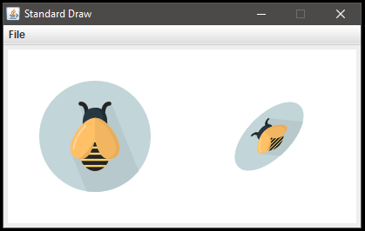
Adding Image Files
StdDraw.clear(StdDraw.WHITE);
StdDraw.picture(100, 100, "bee.png");
StdDraw.picture(300, 100, "bee.png", 100, 50, 45);
This bee.png image is centered at (300, 100). It has been resized to 100 pixels wide by 50 pixels tall and then rotated 45 degrees.
This bee.png image is centered at (100, 100) and displayed at its original size and orientation.
NOTE: Your image file (“bee.png” in this case) MUST be in the same folder as your java classes.

Slide 11
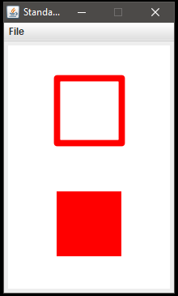
Canvas & Drawing Quick Reference
//Canvas related
setCanvasSize(int width, int height)
setXscale(double min, double max) //recommended values: min=0 and max=width
setYscale(double min, double max) //recommended values: min=0 and max=height
clear(Color color) //clears canvas using requested background color
//Pen settings
setPenRadius(double r) //use value between 0 (very small) and 1 (very big)
setPenColor(Color color)
//Shapes
point(double x, double y)
line(double x0, double y0, double x1, double y2)
circle(double x, double y, double radius)
ellipse(double x, double y, double halfWidth, double halfHeight)
square(double x, double y, double halfLength)
rectangle(double x, double y, double halfWidth, double halfHeight)
polygon(double[] xValues, double[] yValues)
//Filled shapes (These shapes will be filled in with the current pen color.)
filledCircle(double x, double y, double radius)
filledEllipse(double x, double y, double halfWidth, double halfHeight)
filledSquare(double x, double y, double halfLength)
filledRectangle(double x, double y, double halfWidth, double halfHeight)
filledPolygon(double[] xValues, double[] yValues)
square() vs
filledSquare()

Slide 12
Color Quick Reference
//Final (constant) color values found in StdDraw
StdDraw.BLACK StdDraw.DARK_GRAY StdDraw.PINK
StdDraw.BLUE StdDraw.GRAY StdDraw.PRINCETON_ORANGE
StdDraw.BOOK_BLUE StdDraw.GREEN StdDraw.RED
StdDraw.BOOK_LIGHT_BLUE StdDraw.LIGHT_GRAY StdDraw.WHITE
StdDraw.BOOK_RED StdDraw.MAGENTA StdDraw.YELLOW
StdDraw.CYAN StdDraw.ORANGE
Or use your own colors by constructing a Color object from RGB (Red/Green/Blue) values:
Include this import in your class: import java.awt.Color;
Find the color you want in any online color selection tool that will give you the R, G and B values as integers from 0 to 255. Example: R-150, G-0, B-255 means the color has a good amount of red, no green, and a full amount of blue. Didn’t art class teach you that red and blue make purple?
Create your color object: Color myPurple = new Color(150, 0, 255);
Use your color object as a parameter in your StdDraw calls that require a color.
StdDraw.setPenColor(myPurple); or StdDraw.clear(myPurple);

Slide 13
Text & Images Quick Reference
//Adding Text
text(double x, double y, String message) //centers your message on (x, y)
text(double x, double y, String message, double degrees) //rotates centered message
textLeft(double x, double y, String message) //left aligns message to (x, y)
textRight(double x, double y, String message) //right aligns message to (x, y)
//Adding images
picture(double x, doubly y, String filename)
picture(double x, doubly y, String filename, double degrees)
picture(double x, doubly y, String filename, double scaledWidth, double scaledHeight)
picture(double x, doubly y, String filename, double scaledWidth, double scaledHeight, double degrees)
x and y indicate the location of where your image will be centered.
filename (ex: "bee.png") is the name of a file that MUST be in your project folder.
degrees indicates how much to rotate the image
scaledWidth and scaledHeight can be used to resize or distort your image

Slide 14
Don’t forget about the API
There’s soooooo much more you can do with Standard Draw, although some of it gets pretty technical. Don’t be afraid to try things out.
API: javadoc for Class StdDraw

